Slide 1

INFM 600: Information Environments
Week 7: Relational databases
Dr. Andrea Wiggins | October 12 & 13, 2016

Slide 2
Today’s Episode
Overview
Feedback on work plans
Why SQL?
Intro to relational DBs
ERDs
Intro to Quarry
SQL Intro: SELECT & JOIN
Paired activity: SQL query tutorial
Break
Quarry: demo, activity, discussion
Mid-semester feedback
REMINDER: Quarry queries assignment due next week

Slide 3
Work Plans
Congrats, you can follow directions! (big improvement)
Many questions need adjustments
If you focused a lot on prediction, I recommended looking at existing trends – prediction is TOO COMPLEX
Get specific in the questions to help direct analysis
In some cases, drill down into details of the bigger question
Half the effort allocations are pretty much useless
Ensuring equal effort requires getting specific about tasks
Consider having each team member coordinate your parallel efforts for different assignments
Some timelines more realistic than others…
If you left only a week or two for data cleaning, that might be low
Often missing key deadlines, tasks, progress meeting (!), etc.
Only ONE explicitly planned time for editing and integration!

Slide 4
Why SQL?
Helland (2016) focuses on “singularity” : making a dynamic stream of data appear static
Nearly all relational databases rely on SQL for querying & maintenance
Major advantages of SQL:
More efficient than hierarchical models
Pre-defined metadata & well-defined schemas
Serial operations appear concurrent; doesn’t matter what order operations occur for multi-table transactions
Supports set-oriented operations (relational algebra)
Well-bounded: maintenance & use is not complicated
Drawbacks:
Requires everything to be well-defined (metadata!)
Data & schema must be static for set operations to work

Slide 5
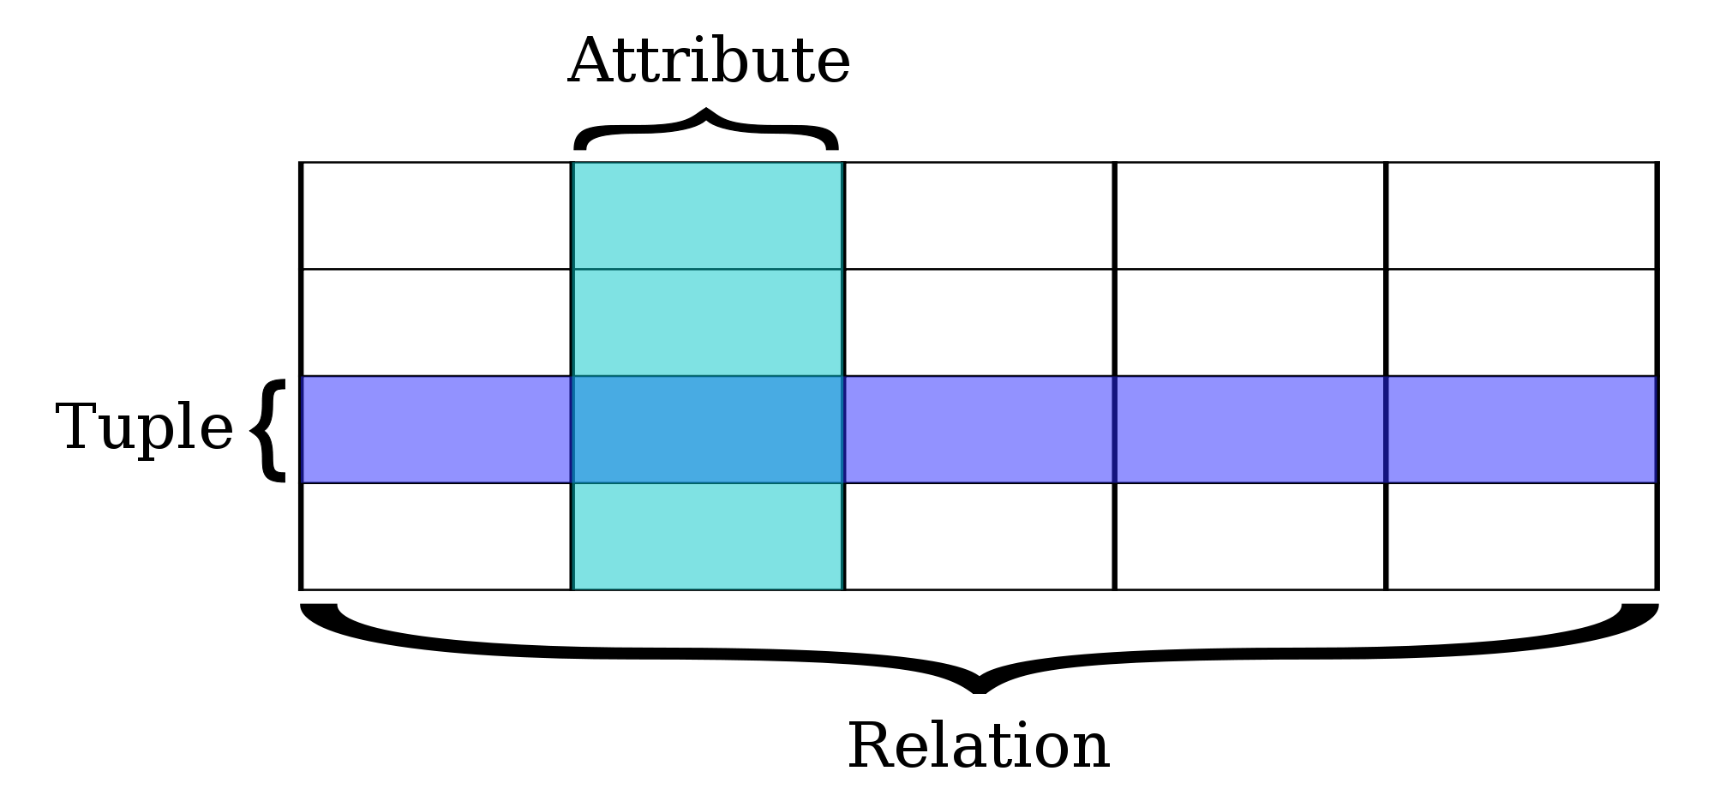
Relational databases
“database structured to recognize relations among stored items of information”
Relational model proposed by E. F. Codd in 1970
DB: 1+ tables with columns, rows, & IDs
Rows = “tuples” or “records”; each is by definition unique
Columns = “attributes” or “fields”; “domain” is possible values
Table = “relation”, set of tuples with same attributes

Slide 6
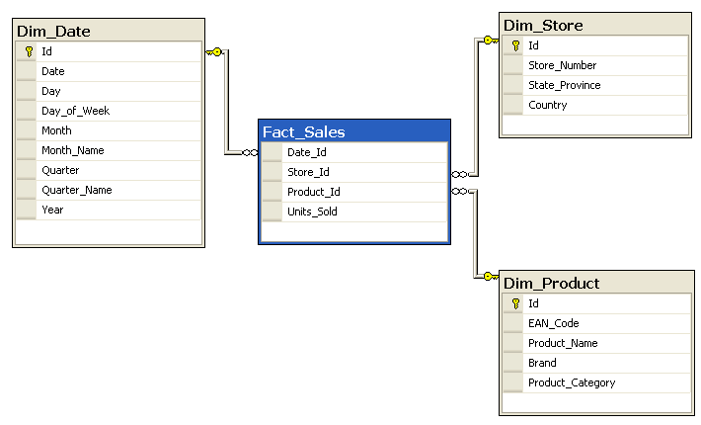
Keys & Indexes
With multiple tables…
Keys are attributes that make links between tables
Each table has a primary key (PK)
PK for one table is foreign key for another
Indexes: stored combinations of attributes on relation (performance)

Slide 7
Queries
“Views” or “result sets” are tuples matching a query
Used with an abstraction layer for presentation
Queries are relational operations using “relational algebra”
Originally 8 operations proposed; extensions since then
Most important operators for our purposes
SELECT: retrieves specified fields (SELECT a FROM b)
WHERE: adds criteria to selection (SELECT x WHERE y)
JOIN: relations connected by common attributes
LIMIT: reduces the size of result sets (useful with Quarry!)
You can also:
Do math in the query results; use Boolean operators (AND, OR)
Order the results (ORDER BY) and group them (GROUP BY)
Use aliases for easier query writing (SELECT x FROM y AS z)
Notes:
Math: avg, count, first, last, min, max, sum,

Slide 8
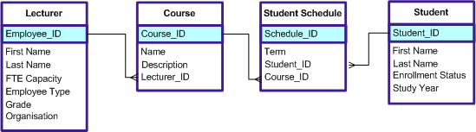
Schemas
Database structure or “schema” represented in ERD
Entity relationship diagram
What you need to know to read ERDs
Standardized representation includes table name, key IDs, & other attributes
Connectors between tables show 1-to-1, 1-to-many relationships
Key ID names sometimes changed when used as foreign keys

Slide 9
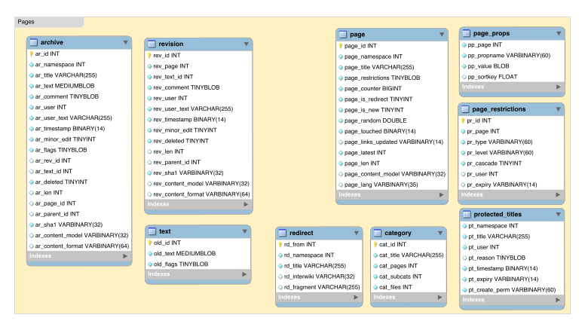
Example ERD: Mediawiki (Pages)

Slide 10
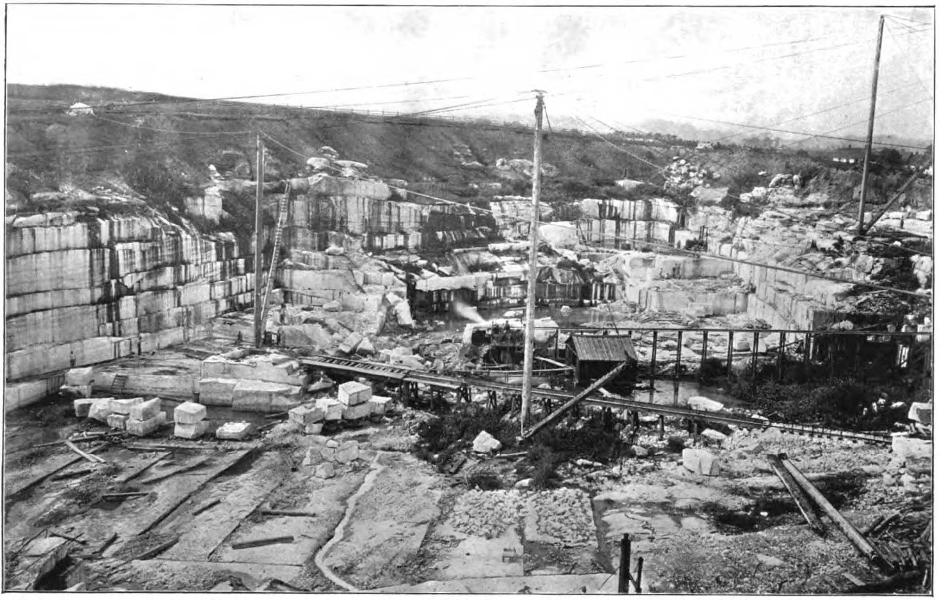

Quarry
Wikimedia Foundation Labs project
Mirrors ALL of Wikipedia, slight delay from live production DB
HUGE amount of data, complex structure
Used by many people for many reasons – mostly Wikipedia editors & admins
Play on words: a quarry is where you mine for resources; query and quarry are almost-homonyms

Slide 11
Quarry
Wikimedia Foundation Labs project
Mirrors ALL of Wikipedia, slight delay from live production DB
HUGE amount of data, complex structure
Used by many people for many reasons – mostly Wikipedia editors & admins
Play on words: a quarry is where you mine for resources; query and quarry are almost-homonyms
Main Quarry features
SQL query access through simple interface (no software needed)
Allows you to save queries (useful for maintenance)
Maintains open query history (useful for ideas & monitoring)
Allows you to fork queries (useful for building on others’ work)

Slide 12
SQL intro: SELECT
SELECT <attribute/s> FROM <table>
SELECT * FROM page
SELECT page_title FROM page
SELECT <attribute/s> FROM <table> WHERE <condition>
SELECT page_title FROM page WHERE page_title LIKE “%wtf%”
SELECT <attribute/s> FROM <table> LIMIT <integer>
SELECT page_title FROM page LIMIT 100

Slide 13
SQL intro: JOIN
INNER JOIN: only gives you rows present in both tables
SELECT <attribute1>…<attributeN> FROM <table1> INNER JOIN <table2> ON <table1.id> = <table2.id> WHERE <conditions> ORDER BY <attributeX> ASC/DESC LIMIT <integer>
OUTER JOINs: 3 types, all must specify IDs to match on
LEFT: includes rows from A even if no match in B
RIGHT: includes rows from B even if no match in A
FULL: includes rows from both tables

Slide 14
SQL Query Activity
Show of hands: are you already familiar with SQL?
Partner up: more experienced + less experienced
Less experienced person MUST be the “driver”, more experienced person can’t just tell them what to type
Go to: www.SQLbolt.com, pick Lesson 1 “Interactive Tutorial”
Go through Lesson 1 to Lesson 4 & SQL Review together
If you finish the tutorials before time’s up, do Lesson 6
If you don’t get all the way through before time’s up, you can always come back to it another time!

Slide 15
Break
10 minutes!

Slide 16
Demo: Quarry
USE
enwiki/simplewiki
हिन्दी: hiwiki/bnwiki/tawiki/tewiki/mrwiki/urwiki/guwiki/knwiki/mlwiki/pawiki/orwiki/aswiki/sawiki
維基/维基: zhwiki/mnwiki
Thanks/month → different time range
Questions to answer:
What is the purpose of this query?
What would we have to know to better understand the query?
What would we have to know to better understand the results?

Slide 17
Activity: Quarry
Find an “interesting” SELECT query and try to interpret it (something with results)
Fork query, modify & run it: repeat as needed until it works
What does the modified version do?
Name your fork, save, & share URL on Canvas with a short description of what it does
Recommended: run one query per pair at a time, and use a LIMIT of 100 or 500 (max). If too many queries get queued, no one gets results.

Slide 18
Discussion: Quarry
Give an example of a query you worked with
Who do you think are the primary users of Quarry? What are their reasons for using it?
What additional information/resources would make it easier for you to use Quarry?

Slide 19
Mid-semester feedback
Anonymous, just for class improvement
Different feedback than course evals
We’ll do a separate eval for Jonathan in December

